Slide 1
DAYANANDA SAGAR ACADEMY OF TECHNOLOGY AND MANAGEMENT (Affiliated to Visvesvaraya Technological University, Belagavi & Approved by AICTE, New Delhi) 22 Mile, B.M Kaval, Opp. to Art of Living, Udayapura, Kanakapura Road, Bangalore-560082. DEPARTMENT OF COMPUTER SCIENCE & ENGINEERING (Accredited by NBA, New Delhi for 3 Years Validity: 26-7-18 to 30-6-2021)
VTU Innovative Project- 2021
Group Number | 02 | Subject Code | 17CSP78
Student Names | SONAL UDAPUDI | USN | 1DT17CS094
 | SONIKA R |  | 1DT17CS095
 | ARAVIND E M |  | 1DT18CS402
 | PRASAD SHIVAM |  | 1DT16CS066
Project Title | AUTOMATIC SOIL PARAMETERS AND CROP DETECTION MANAGEMENT SYSTEM USING IOT
Guide Name | PROF. ANOOP G L

Slide 2
Agenda:
Introduction
Modules identified
Algorithm
Results
Future scope
Conclusion
Paper publication details

Slide 3
Introduction
Creating a system that identify the crop by data of certain basic soil parameters(temperature, humidity, rain, soil moisture, etc) .
Comparison between standard data and measured data is done based on predefined parameters.
The model is portable and used by farmers directly in the fields to measure the various basic parameters.
We are going to construct a smart agricultural monitoring system which can collect crucial agricultural data and send it to an IoT platform or the csv file in real time where the data can be logged and analyzed.

Slide 4
Smart agriculture monitoring system or simply smart farming is an emerging technology concept where data from several agricultural fields ranging from small to large scale and its surrounding are collected using smart electronic sensors.
The collected data are analyzed by local farmers to draw short term and long term conclusion on weather pattern, soil fertility, current quality of crops, amount of water that will be required for next week to a month etc.

Slide 5
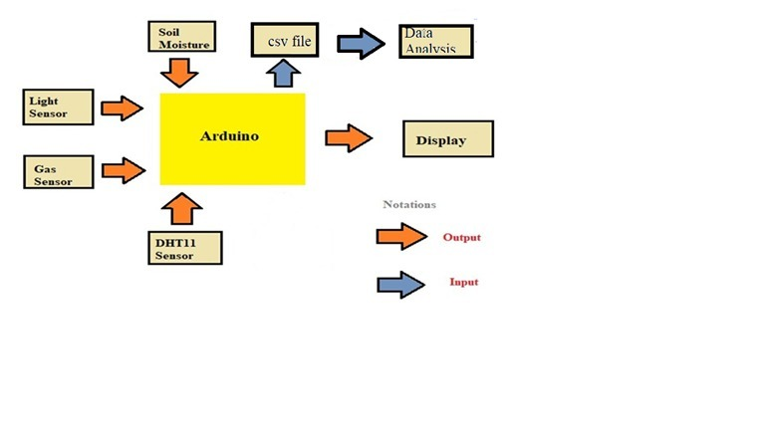
Block Diagram

Slide 6
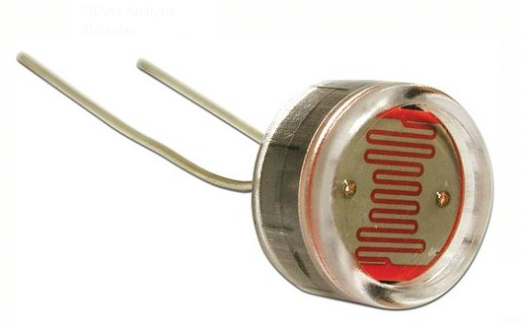
Modules 1
Sensor: This project consists of Arduino as brain and we are utilizing 4 sensors which measures six different environmental factors that crop’s growth and nourishment depend on.
1.Light Sensor:
The amount of light received on a plot is measured using LDR(Light Dependent Register) or photo-register.

Slide 7
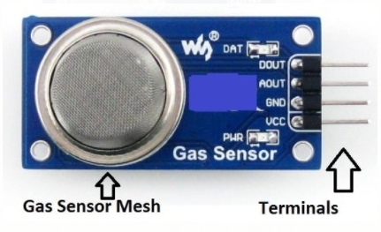
2.Gas Sensor:
The quality of air needed for the plants is measured using gas sensor(like MQ135).
MQ135 has 4 terminals and out of which 3 of them are used(Vcc,GND and Aout).

Slide 8
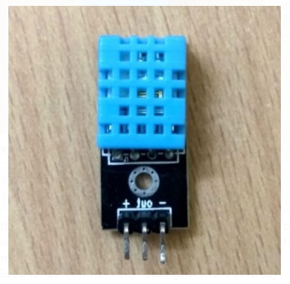
3. Temperature and Humidity Sensor(dth11)
dth11 uses a capacitive humidity sensor and a thermistor to measure the surrounding air, and spits out a digital signal on the data pin.
new data from it is received once every 2 seconds.

Slide 9
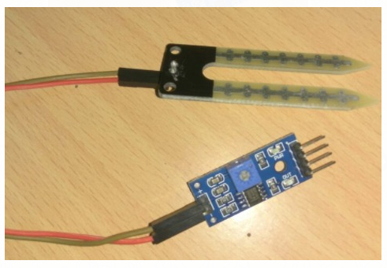
4.Soil Moisture Sensor:
The soil moisture can be measured using the soil moisture senor, which has two prongs (electrodes) which are to be inserted on top layer of soil.
This is an analog sensor which will output analog values to Arduino.

Slide 10
Modules 2
Arduino: Our project is a mixture of hardware and software additives . The hardware part includes embedded systems and software part program is developed using Arduino ide.
The Arduino Uno is an open-source microcontroller board based on the Microchip ATmega328P microcontroller and developed by Arduino company.
The board is equipped with sets of digital and analog input/output pins that may be interfaced to various expansion boards and other circuits.
The gathered information is displayed in a Arduino IDE.

Slide 11
Modules 3
Machine Learning (ML) technique is used to identify the crop and ultimately increase the yield of the crop.
First, these works consist of data acquisition model for collecting agricultural field data using sensor nodes.
Next, the data is trained using the ML algorithm for predicting the soil moisture and other parameters for yield maximization.
Finally, decision are made that which crop is suitable for that environment.

Slide 12
Algorithm
A decision tree is a flowchart-like tree structure where an internal node represents feature(or attribute), the branch represents a decision rule, and each leaf node represents the outcome.
The working of the decision tree classifier algorithm is explained in the below steps:
Select the best attribute using Attribute Selection Measures(ASM) to split the records.
Make that attribute a decision node and breaks the dataset into smaller subsets.
Starts tree building by repeating this process recursively for each child until one of the condition will match:
*All the tuples belong to the same attribute value.
*There are no more remaining attributes.
*There are no more instances.

Slide 13
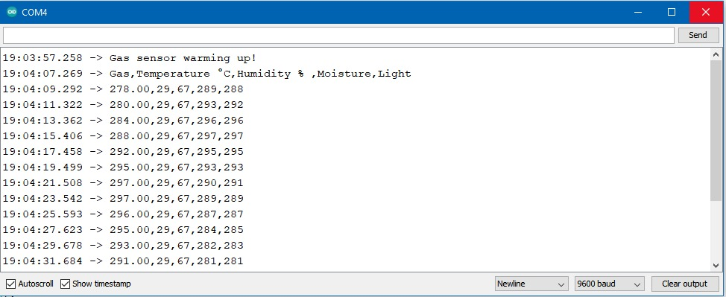
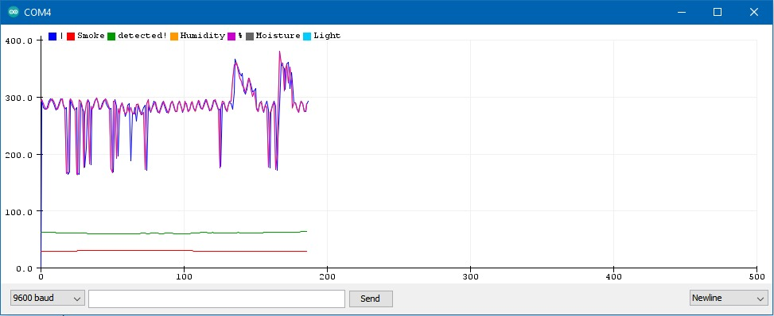
Results
Fig 1: Output in Arduino ide.
Fig 2: Serial Plotter of the readings from sensors.

Slide 14
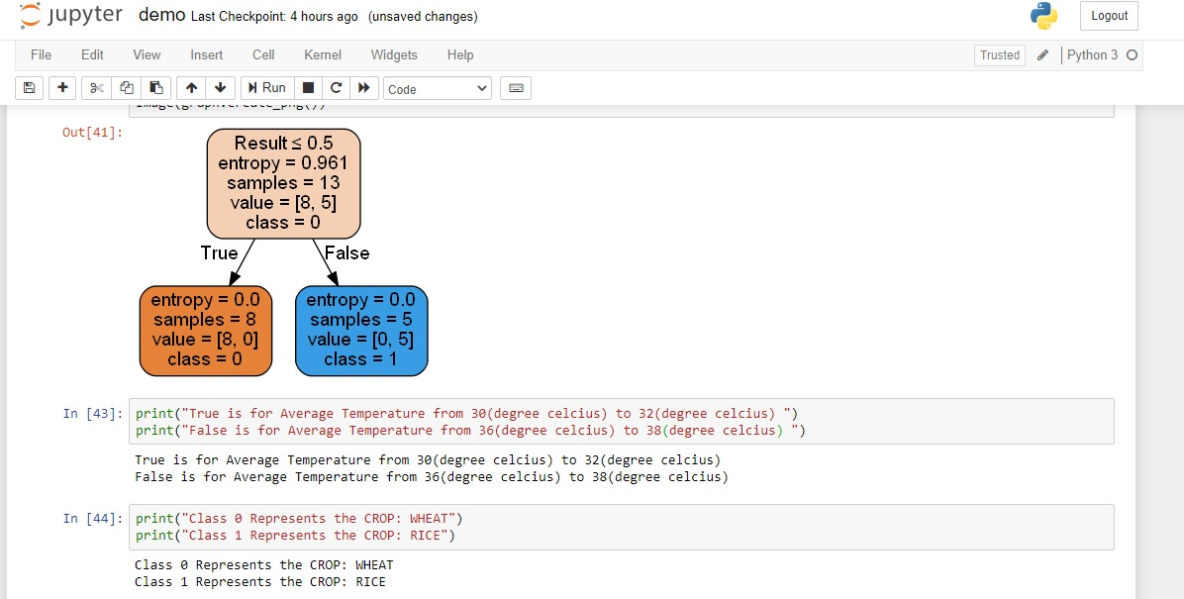
Fig 3: Algorithm output for crop prediction.

Slide 15
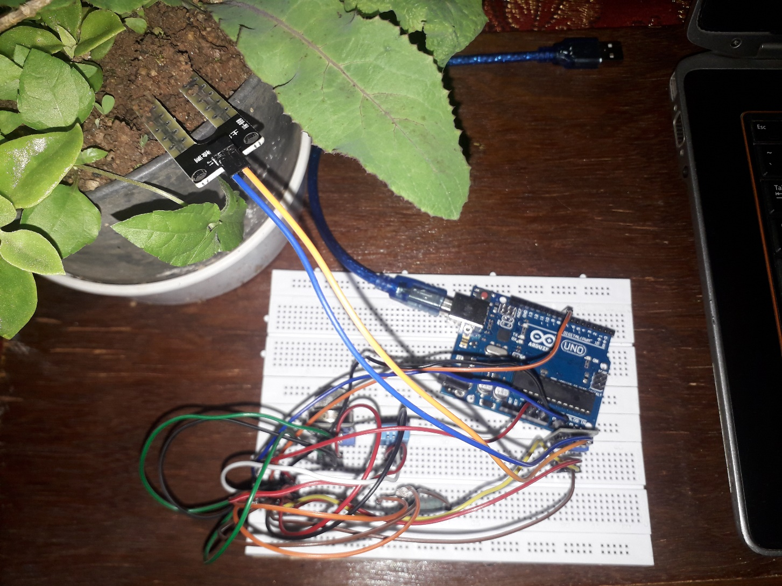
Fig 4: Working Model.

Slide 16
Future Scope
In the future, a great number of parameters can be monitored. Application can be made to get visual and audible alert whenever there is any unfavorable condition.
The system can be enhanced further to add following functionality: Use of soil moisture sensors, environment sensors, pH sensors to increase the accuracy while predicting the crop.
Locations market requirements can be consider, and neighbor farmers crop while suggesting the suitable crop.

Slide 17
Conclusion
A new model is proposed for real time soil and environment monitoring. Parameters (temperature, humidity, moisture content, light and gas) are monitored.
Sensor values are stored in the csv files.
Data analysis can be done by using decision tree classifier algorithm (Machine Learning).
On the basis of collected parameters appropriate decisions for crop predictions are made using machine learning algorithm.

Slide 18
Paper Publication Details
Journal Name :International Journal of Advance Research and Innovative Ideas in Education
Paper ID :14139
Paper Title :Automatic soil nutrients and crop detection Management System Using IoT.
Area : Computer Science and Engineering
DUI : 16.0415/IJARIIE-14139
Journal website : http://ijariie.com/currentIssue.aspx
Publication Date: 6 May,2021

Slide 19
References
Rishika Anand, Dimple Sethi, Kavita Sharma, Pooja Gambhir. "soil moisture and atmosphere components detection system using IOT and machine learning", Second International Conference on Smart Systems and Inventive Technology (ICSSIT 2019),IEEE Xplore Part Number: CFP19P17-ART; ISBN:978-1-7281-2119-2.
Ashwini A. Chitragar, Sneha M. Vasi, Sujata Naduvinamani, Akshata J. Katigar and Taradevi I. Hulasogi “Nutrients Detection in the Soil”. International Journal on Emerging Technologies (Special Issue on ICRIET-2016) 7(2): 257-260(2016)
Arun M. Patokar, Dr. Vinaya Vijay Gohokar. “Automatic Investigation of Micronutrients and fertilizer dispense System using Microcontroller”. (ICRIEECE) 2018
Bah. A, S.K. Balasundram, M.H.A. Husni. “Sensor Technologies for Precision Soil Nutrient Management and Monitoring”.American Journal of Agricultural and Biological Sciences 7 (1): 43-49, 2012

Slide 20
Q & A

Slide 21
Thank You

